Slide 1
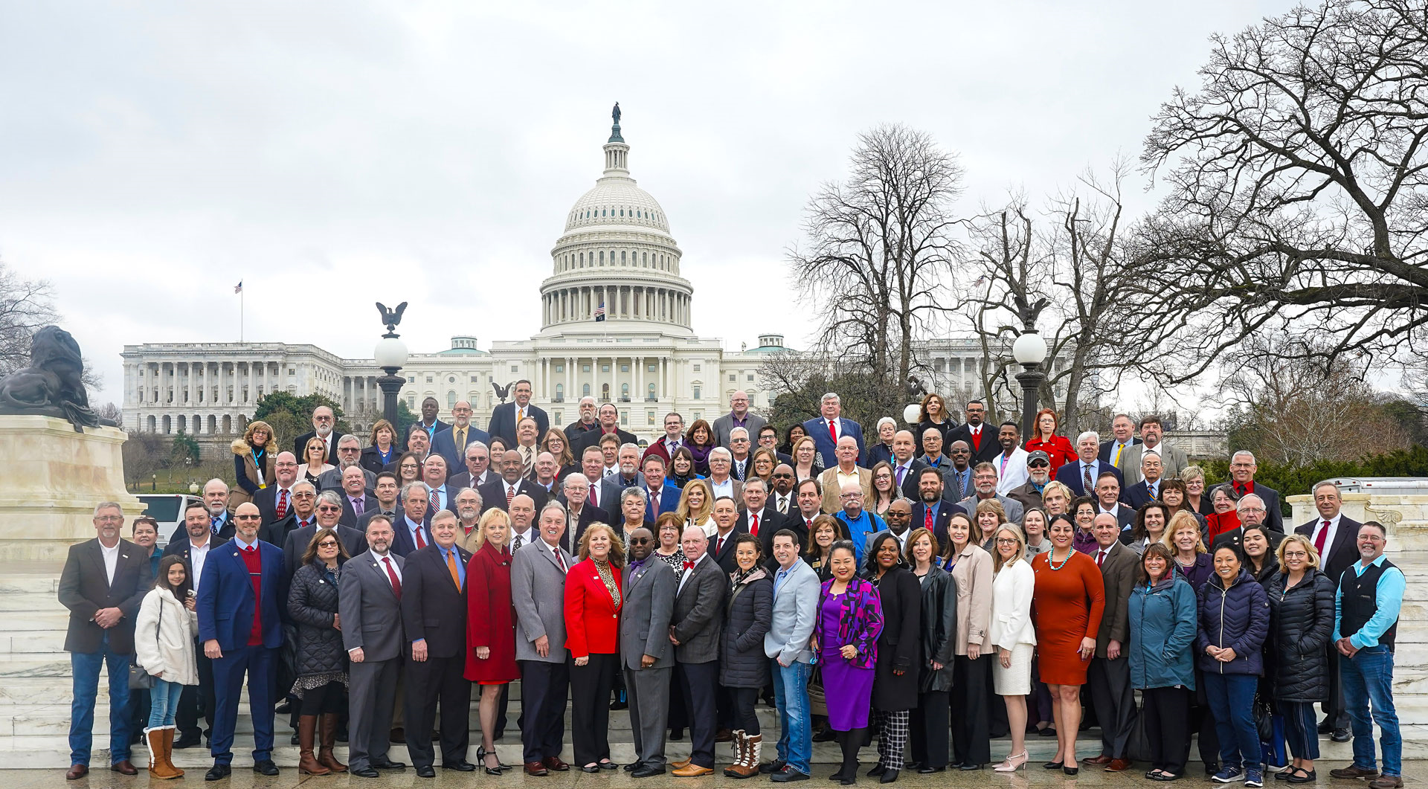

NATIONAL ASSOCIATION OF COUNTIES
Tennessee County Services Association Fall Conference
October 2025

Slide 2
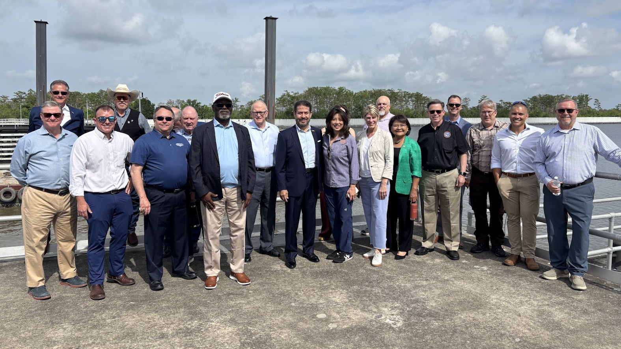

NACo Intergovernmental Disaster Reform Task Force Advocacy
Access the Task Force Landing Page

Slide 3
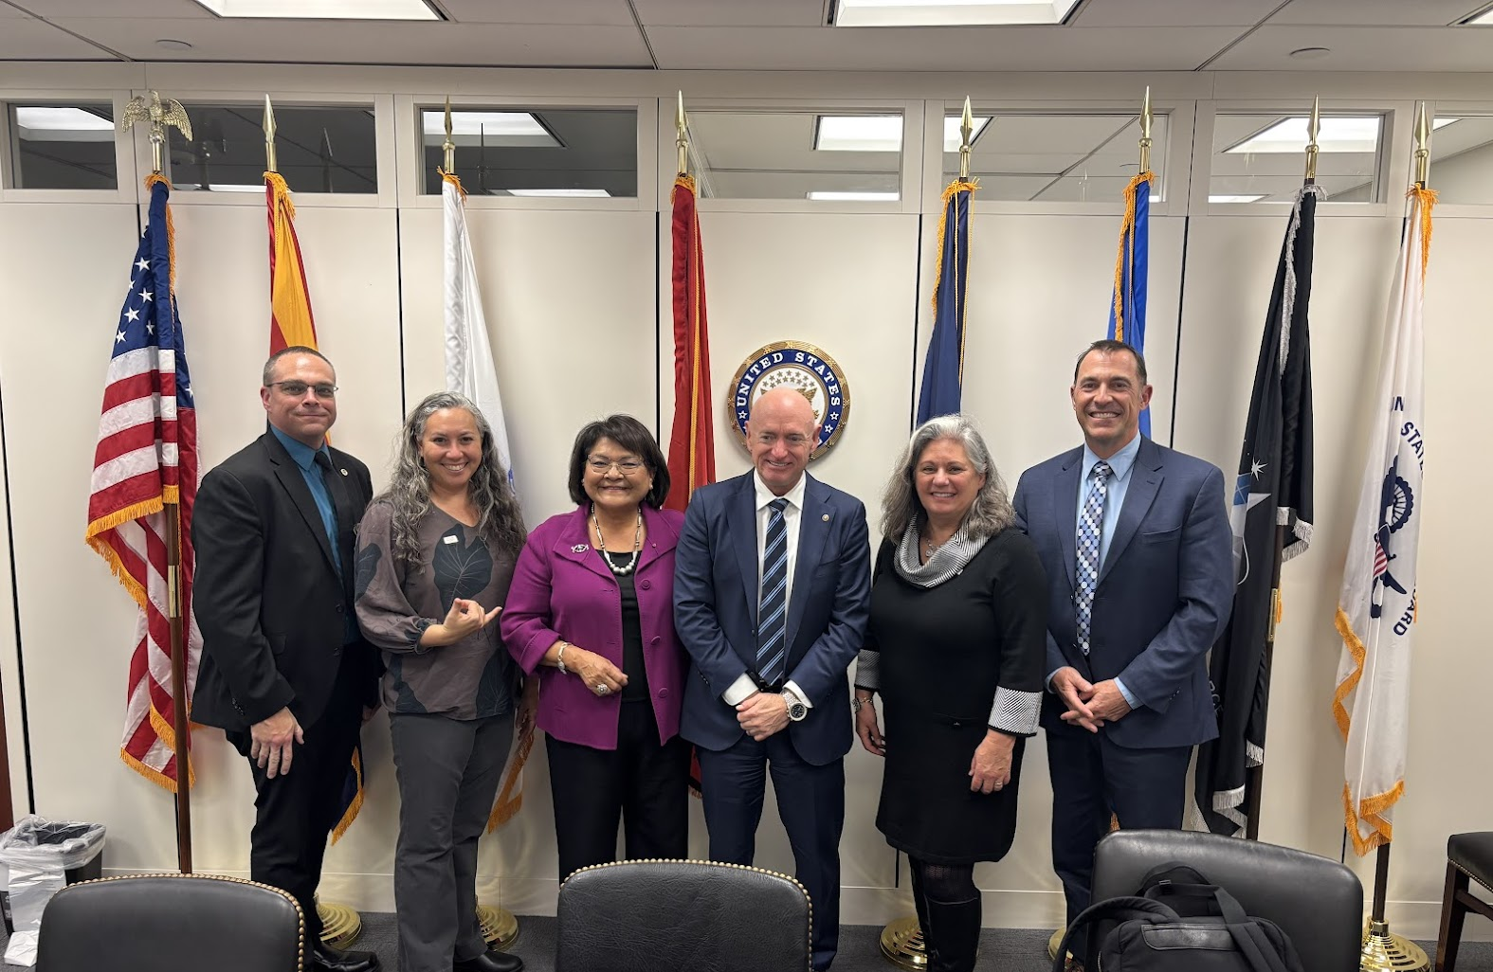
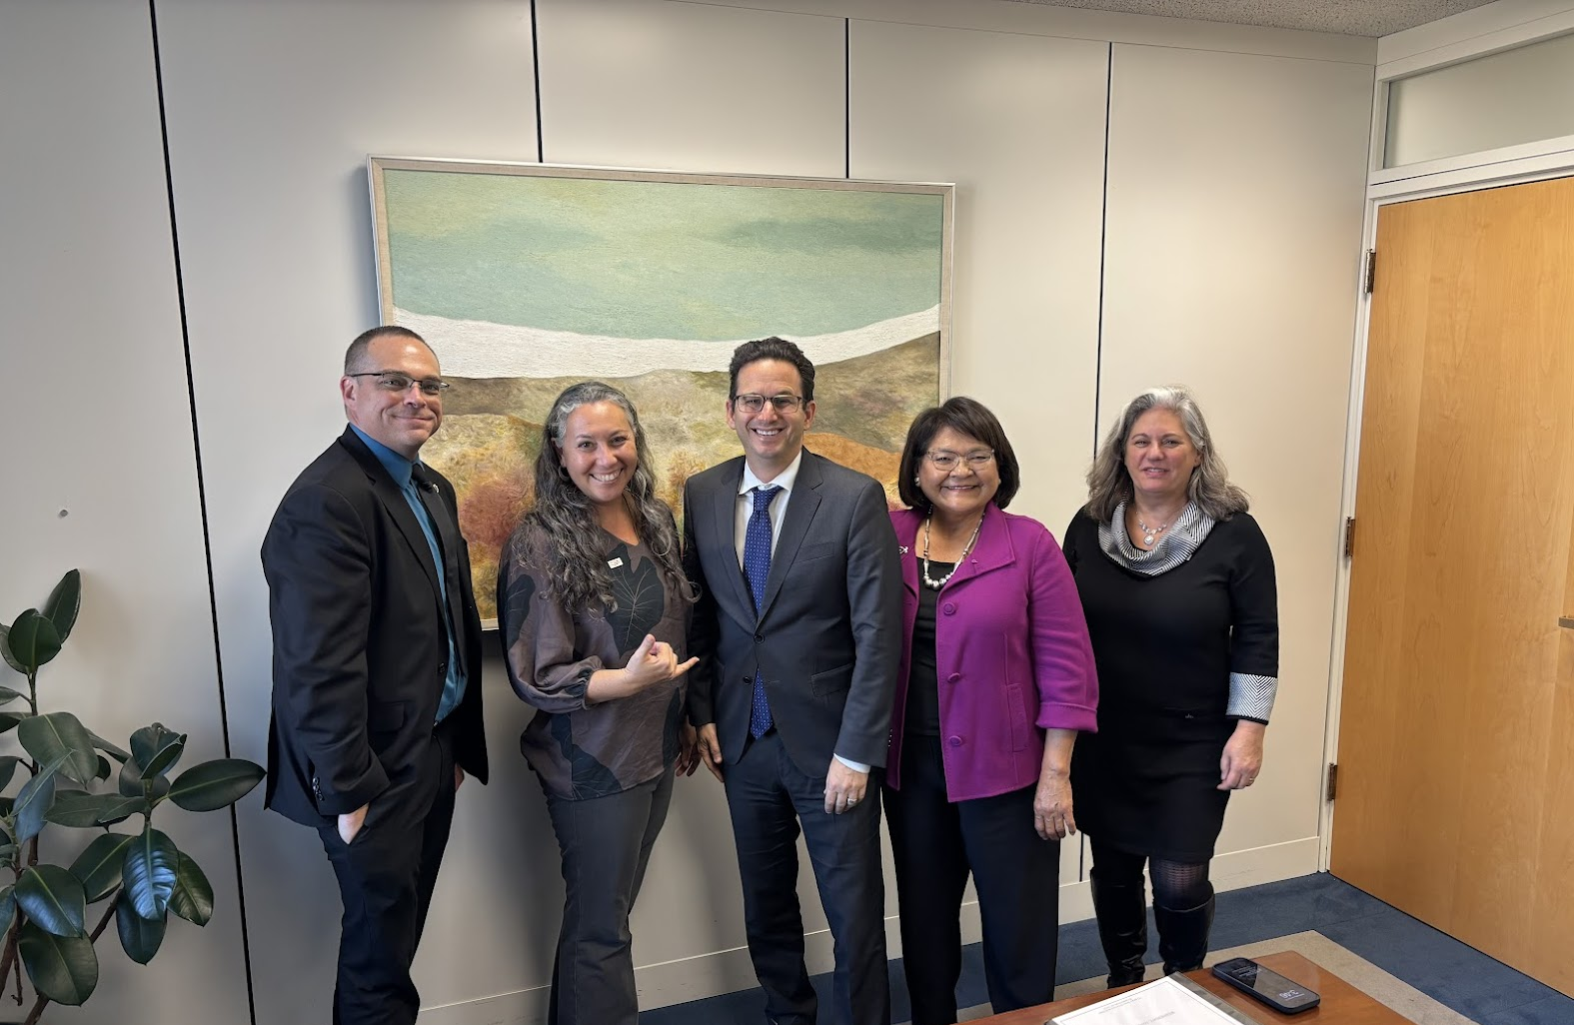
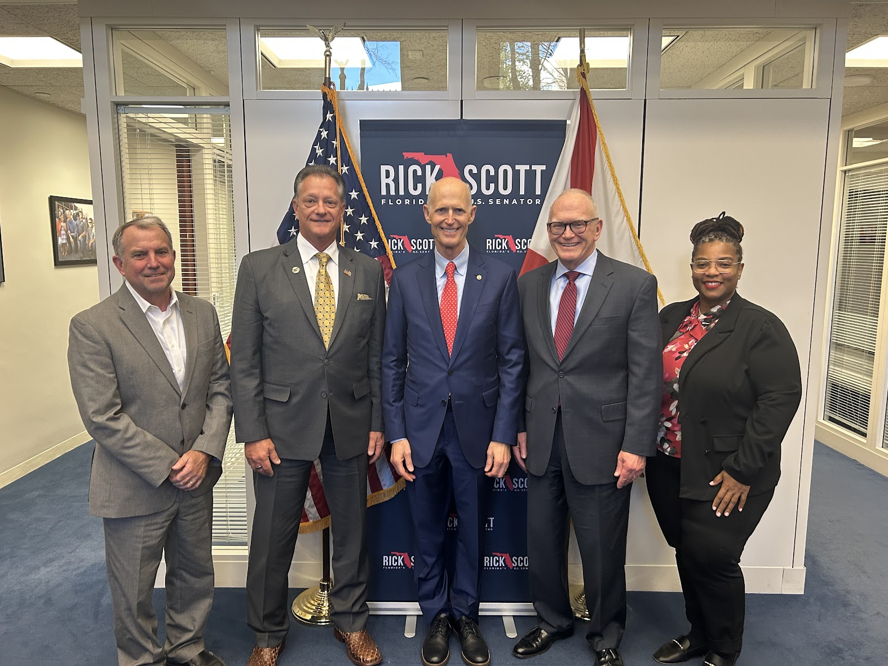
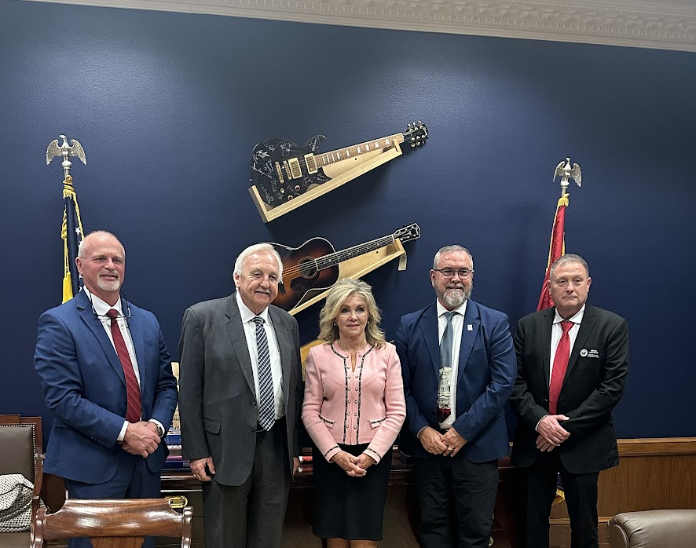
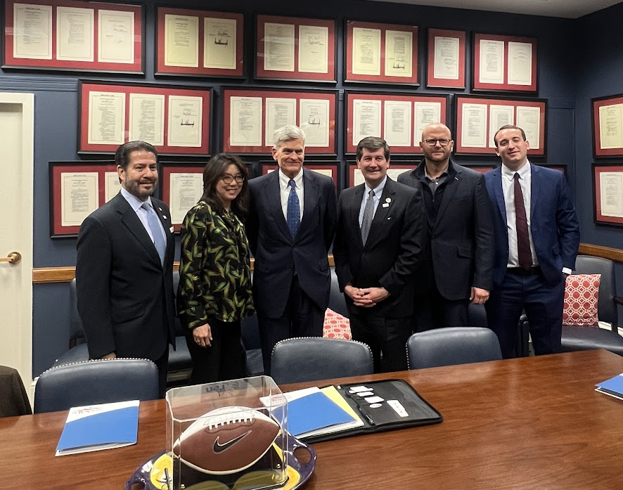

Slide 4

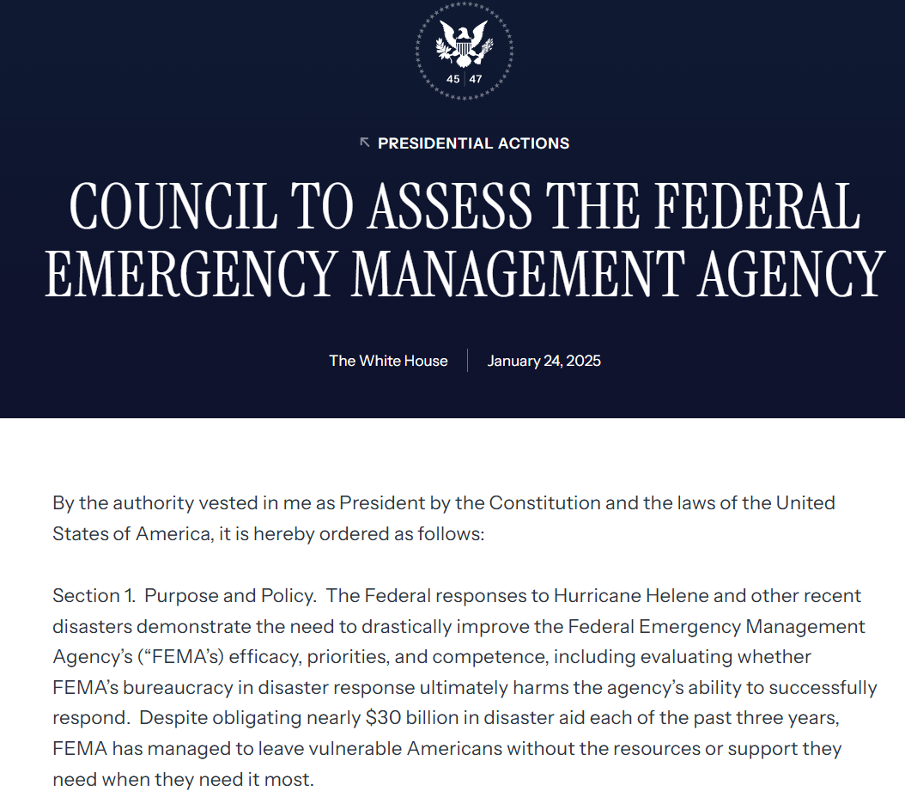


Executive Order 14180: Council to Assess the Federal Emergency Management Agency
EO Establishing FEMA Review Council
January 24, 2025
. Council Members are Appointed
April 28, 2025
Council Convenes for First Meeting
May 20, 2025
November 16, 2025
Report Due

Slide 5
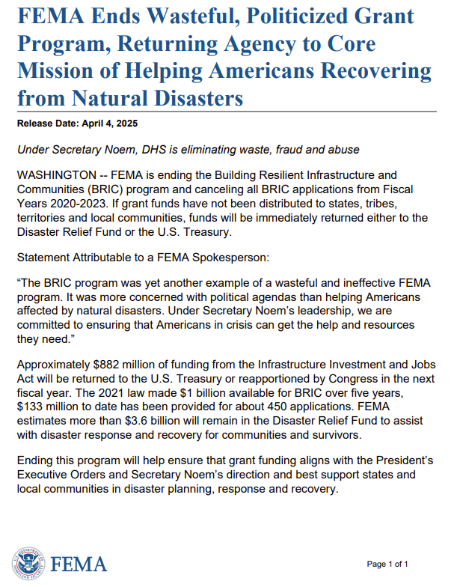

Cancellation of the BRIC Grant Program
NACo Blog

Slide 6
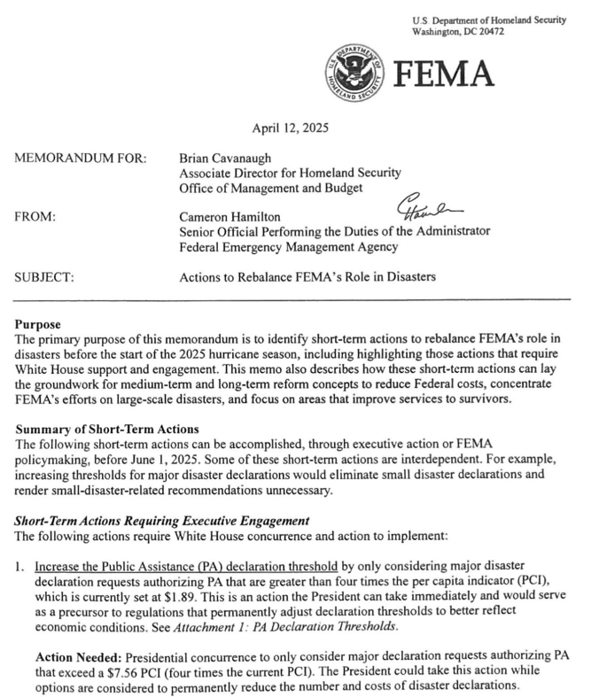

FEMA Memorandum
View the Memo

Slide 7
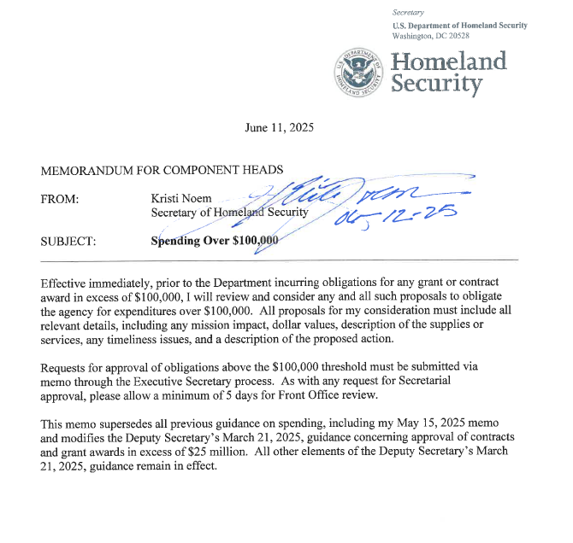
DHS Spending Memorandum

Slide 8


Fixing Emergency management for Americans (FEMA) Act (H.R.4669) Overview
July 24: House Transportation and Infrastructure (T&I) Committee Chair Sam Graves (R-Mo.) and Ranking Member Rick Larsen (D-Wash.) introduce bipartisan FEMA Act.
September 3: House T&I Committee clears FEMA Act by an overwhelming margin of 57-3.
Key wins for counties:
Transitioning the Public Assistance Program from a reimbursement to a grant model, with the opportunity for grants to be made directly to counties.
Streamlining environmental and historic preservation reviews.
Creating a universal disaster application for disaster survivors.
Restructuring of FEMA's pre-disaster mitigation program by moving it to a formula-based grant.
Creating a Public Assistance dashboard that publicly displays information for each major disaster declaration.
Next steps: House floor vote pending. Discussions beginning on Senate companion.
Scan here to access NACo’s analysis of the bill
National Association of Counties | www.NACo.org |October 2025| 8

Slide 9
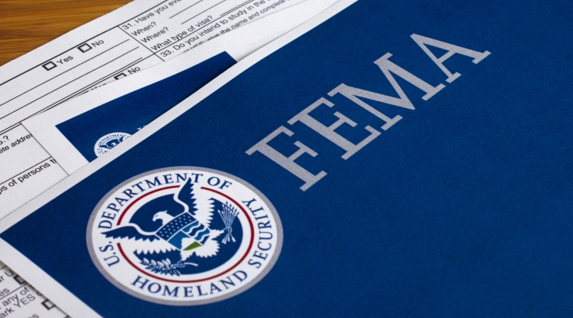
Establishing FEMA as a Cabinet-Level Agency and Outlining Roles
Establishes FEMA as a Cabinet-level agency, removing it from the U.S. Department of Homeland Security.
Outlines criteria for being the FEMA Administrator and Deputy Administrator, including no less than five years of executive leadership and demonstrated understanding of emergency management.
Maintains “All Hazards Approach” to disaster management.
Calls for the creation of a new FEMA Veterans Advocate.
Timeline: Includes a one-year timeline to establish FEMA as an independent agency.
National Association of Counties | www.NACo.org |October 2025| 9

Slide 10
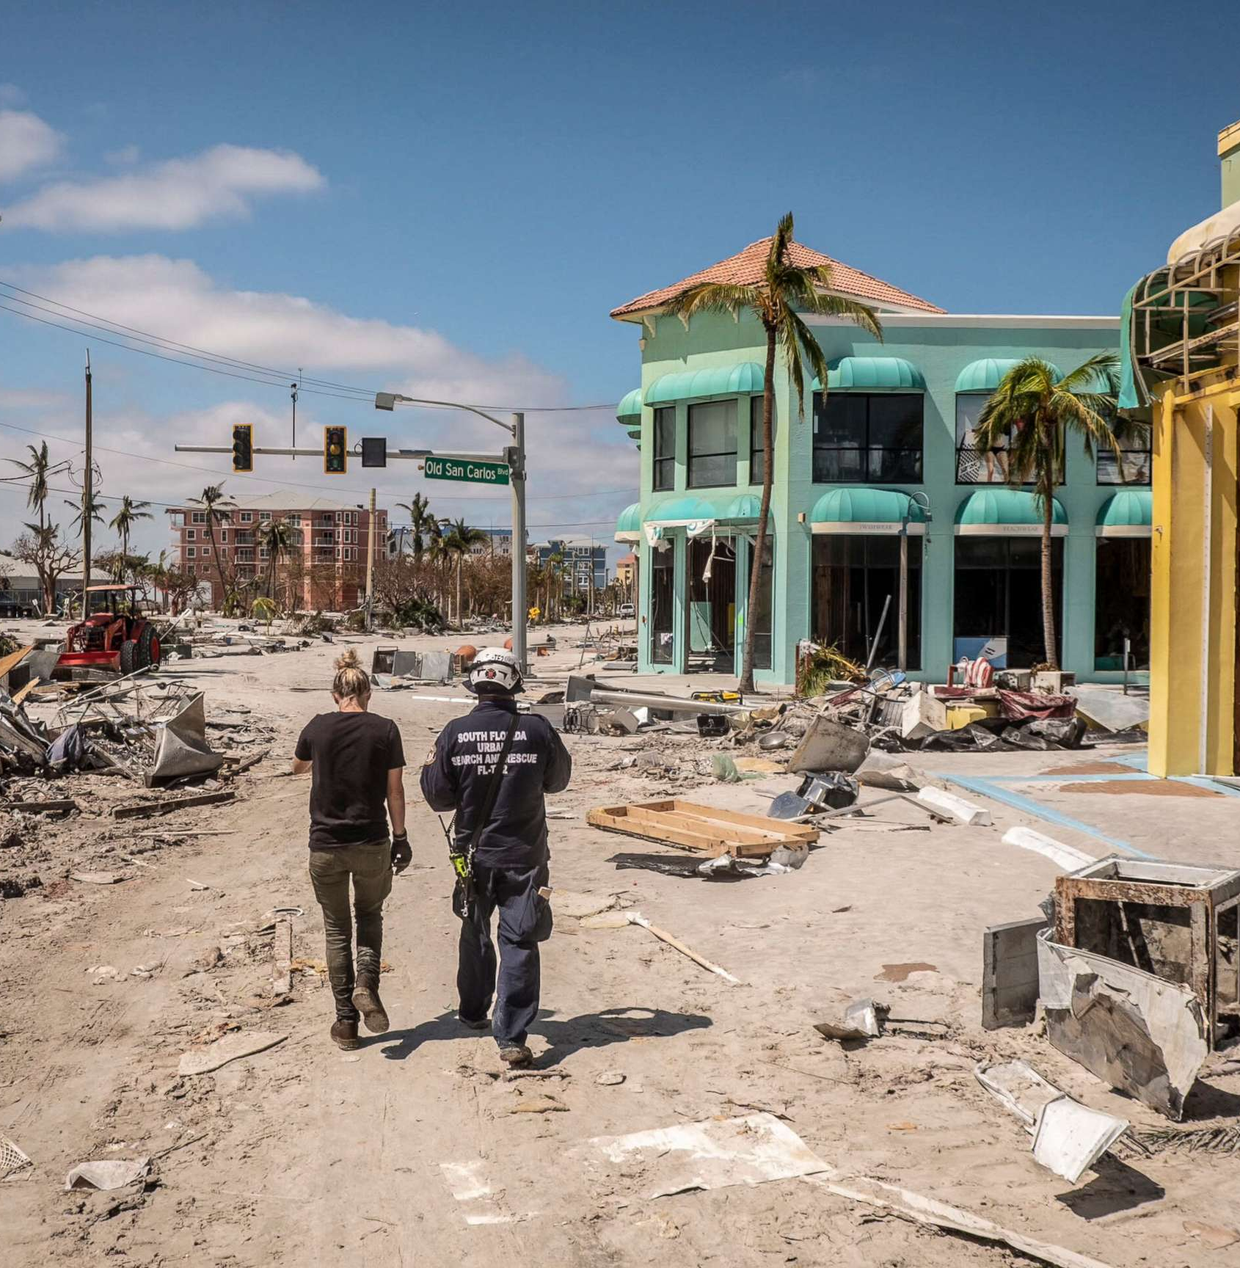
Public Assistance Program Reforms
NACo advocacy win: Transitions FEMA Public Assistance Program from a reimbursement to a grant program, with the opportunity for grants to be made directly to counties.
Cost estimation: Estimate based on cost to repair, restore or replace facility to applicable building codes and would exclude preexisting condition of facility.
One-time adjustment to a project permitted within two years of initial funding release.
Reporting: Annual progress reports with descriptions of projects funded, list of completed projects and projects under construction.
Cost share: Sliding scale from 65 percent – 85 percent, contingent on mitigation measures being implemented.
Timeline: Creates a 120-day shot clock on getting funding out the door
National Association of Counties | www.NACo.org |October 2025| 10

Slide 11
Public Assistance Program Reforms
Creates a task force to examine open disaster claims, which would be tasked with making recommendations to expedite closeout of existing disaster claims.
NACo advocacy win: Streamlines permitting process and expedites environmental and historic preservation reviews by allowing for waivers on already disturbed land, including building up to current codes and including mitigation measures.
Ensures effective and timely debris removal processes by prohibiting any additional requirements from the President that may slow clean up.
NACo advocacy win: Incorporates the Disaster Management Costs Modernization Act, which would allow for management costs to be spread across multiple disasters.
Creates incident period advisory panel with at least two county representatives to provide recommendations on reforming the incident period process.
Incorporates the Fire Management Assistance Grants (FMAG) for Tribal Governments Act, which would allow for tribal governments to directly request FMAG declarations.
Allows for reimbursement for sheltering of emergency response personnel for up to six months after a declared disaster.
NACo advocacy win: Clarifies that under federal procurement regulations as it relates to PA, counties shall be treated as states, allowing for expedited procurement processes and removing bureaucratic red tape.
National Association of Counties | www.NACo.org | October 2025| 11

Slide 12
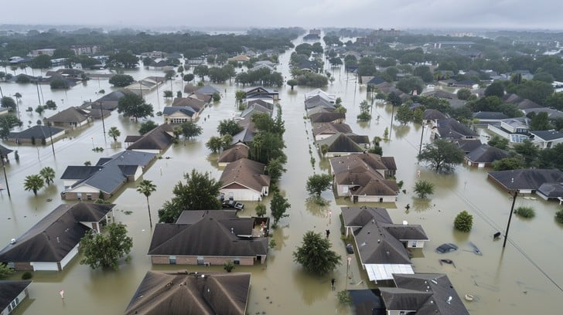
Individual Assistance Program Reforms
NACo advocacy win: Creates a universal disaster application for survivors for programs across FEMA, HUD, SBA and USDA.
Duplication of benefits: Clarifies that receipt of a disaster loan or charitable donation does not make an individual ineligible for FEMA’s Individuals and Households Program.
Authorizes permanent home repairs when more cost-effective than temporary housing and removes the requirement that homes be uninhabitable to qualify for hazard mitigation assistance.
Allows direct aid for repairing disaster-damaged homes when financial assistance falls short, with a focus on people with disabilities and mitigation efforts.
Assistance denial letters: Prevents denial letters being sent before insurance claims are fully resolved.
Directs the Administrator to provide alternative methods to determine assistance eligibility beyond a physical address.
National Association of Counties | www.NACo.org | October 2025| 12

Slide 13
Mitigation Reforms
NACo advocacy win: Restructures FEMA’s pre-disaster mitigation program by transitioning it from a competitive program to a formula-based grant. 50 percent of all funds would be required to be passed through to localities.
40 percent distributed equally among state
20 percent allocated based on vulnerability to natural disasters
20 percent allocated based on state population and lower median income
20 percent based on the number of economically distressed or rural communities
Establishes new state mitigation project plan process that would require each state to submit a list of projects for preapproval.
The plans would be required to have at least one project per county in each state.
Allows for the combining of pre and post disaster hazard mitigation funding for large, innovative mitigation projects.
Creates a consolidated application form for pre and post disaster hazard mitigation funding.
National Association of Counties | www.NACo.org |October 2025| 13

Slide 14
Transparency and Oversight Reforms
NACo advocacy win: Creates a publicly available Public Assistance dashboard that will include:
Information on each PA cost estimate following each major disaster declaration
Status of agency review and approval
Explanation for any cost estimate that is not approved
Project-level progress reports
NACo advocacy win: Creates a publicly available Individual Assistance dashboard that will include:
Number of applicants for IA following each major disaster declaration
Number of approved or denied applicants
Total amount of funding distributed
Requires the Comptroller General to produce a report on existing regulations and policies and provide recommendations for removing or reforming these regulations to speed up processes and decrease administrative burdens.
Requires the creation and maintenance of a federal database that displays all federal assistance distributed by FEMA, SBA and HUD.
National Association of Counties | www.NACo.org | October 2025| 14

Slide 15
Next Steps & Advocacy Opportunities
Increase support for FEMA Act while Members of Congress are home for August recess
Provide letters of support for the bill and feedback on any necessary changes
Collect and share data related to disaster recovery to drive advocacy efforts
Access the congressional form letter
National Association of Counties | www.NACo.org | October 2025| 15

Slide 16

QUESTIONS?
Brett Mattson
Legislative Director – Justice & Public Safety
bmattson@naco.org or 202.942.4234
National Association of Counties
660 North Capitol Street, N.W. | Suite 400
Washington, D.C. 20001
202.393.6226 • www.NACo.org
fb.com/NACoDC
@NACoTweets
youtube.com/NACoVideo
linkedin.com/company/NACoDC
STRONGER COUNTIES. STRONGER AMERICA.

