Slide 1

Juvenile Detention
Challenges in
Tennessee
Hannah Newcomb, Senior Research Associate
TENNESSEE ADVISORY COMMISSION ON INTERGOVERNMENTAL RELATIONS

Slide 2

CONTENTS
3
8
WHAT IS TACIR?
RESEARCH PROCESS
5
10
HOW WE RECEIVE STUDIES
WHAT WE’VE LEARNED SO FAR
7
23
PUBLIC CHAPTER 418
WHAT’S NEXT?

Slide 3

WHAT IS TACIR?
TN Advisory Commission on Intergovernmental Relations
  Part of state government in Tennessee since 1978
  Created at a time when the powers, functions, and relationships among federal, state, and local governments were becoming more complex
3

Slide 4
WHAT IS TACIR?
In many ways, TACIR functions like a think tank.
NONPARTISAN STAFF:
BIPARTISAN COMMISSION:
  12 research staff members
  As the staff, we fulfill research requests for our commission.
  25 members
  10 from the General Assembly and 10 from local government
  The state comptroller, two executive branch members, and two private citizens appointed by the governor round out the rest.
4

Slide 5
HOW WE RECEIVE STUDIES
REQUESTS FROM COMMISSION MEMBERS
STUDY REQUESTS BY LAW
STAFF REPORTS
5

Slide 6
HOW WE RECEIVE STUDIES
  In September of 2024, Representative Reedy received a letter from the City of Germantown, conveying concern over the “overwhelming capacity issues” of juvenile detention facilities throughout West Tennessee.
  The city expressed a need for an additional rehabilitation and detention facility with a capacity exceeding 750 beds.
  In response to these concerns Senate Bill 239 by Senator Taylor and House Bill 40 by Representative Reedy was introduced and passed in the 114th General Assembly as Public Chapter 418, Acts of 2025.
6

Slide 7
Public Chapter 418, Acts of 2025
Directs TACIR to study:
  the availability of facilities that house juvenile offenders who are adjudicated delinquent and in the custody of the Department of Children’s Services (DCS) or who have been detained by the juvenile courts and are awaiting their adjudicatory hearing, and
  whether there is a need for additional housing, detention, and treatment facilities in the state of Tennessee.
7

Slide 8




RESEARCH PROCESS
Background research, literature review, identifying stakeholders
Interviews with stakeholders, data collection and analysis
Panel of stakeholders at the September 2025 Commission Meeting
Writing and presenting our report
8

Slide 9
Setting the Scene
  In 2017 a Joint Ad-Hoc Blue Ribbon task force convened to review the state’s juvenile justice system, data, and national research, and meet with stakeholders.
  The task force produced a report, which resulted in the Juvenile Justice Reform Act of 2018. This led to
    changes about who is eligible for detention,
    uniform data collection from the Administrative Office of the Courts, and
    investment in evidence-based programming and community resources through a recurring, state-funded grant of $4.5 million administered by the Tennessee Department of Mental Health and Substance Abuse Services (TNDMHSAS).
9

Slide 10

WHAT WE’VE LEARNED SO FAR
Facilities for housing and treating juvenile offenders are important components of Tennessee’s juvenile justice system.
If available capacity doesn’t meet the need for placements, it could present risks to the welfare of youth in custody and the general public.
10

Slide 11
WHAT WE’VE LEARNED SO FAR
Pre-adjudication Detention
Youth detained prior to their adjudicatory hearing are placed in juvenile detention centers
  Juvenile detention centers (JDC): hardware secure, short-term holding facilities primarily intended for pre-adjudication detention
  In TN JDCs are operated by either local governments, including juvenile courts, or private entities.
  There are 16 JDCs in the state, with a total combined capacity of 635 licensed beds.
  There are at least three juvenile detention centers in each grand division of the state, but not every county has its own facility.
  Some counties have to transport youth across the state to find an available detention bed.
11

Slide 12
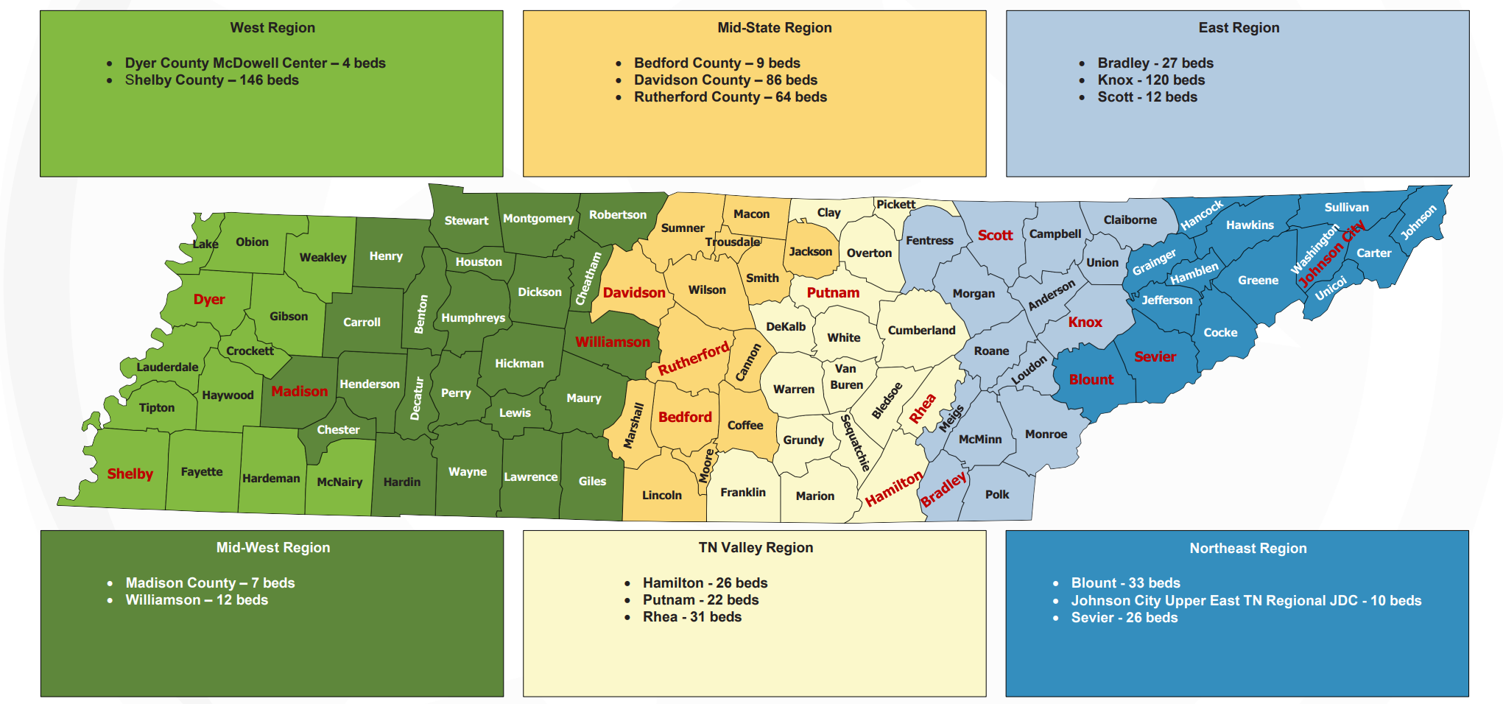
WHAT WE’VE LEARNED SO FAR
Juvenile Detention Centers
Courtesy of the TN Conference of Juvenile & Family Court Judges
12

Slide 13
WHAT WE’VE LEARNED SO FAR
Pre-adjudication Detention
For children detained pre-trial while they await their hearing
  Temporary Holding Resources (THR): hardware secure, emphasis on temporary, 24-48 hours
  There are 5 THRs in the state, with a total of 15 beds
  Located in Cumberland, Hamblen, Loudon, Marion, and Sumner counties
13

Slide 14
WHAT WE’VE LEARNED SO FAR
Post-adjudication Detention
Youth who have been adjudicated delinquent may, at the discretion of the juvenile judge, be committed to DCS custody.
  DCS determines where to place the child based on the severity of the offense and the child’s behavioral, medical, or other treatment needs.
  There are four levels of placement within DCS: (1) foster homes, (2) group homes, (3) residential treatment facilities, and (4) acute treatment programs.
  Level three, residential placements are the most common permanent placement for post-adjudicated JJ youth in DCS custody.
14

Slide 15
WHAT WE’VE LEARNED SO FAR
Staff Secure
Grand Division | Facility Name | Operated by | Capacity
East | Mountain View Academy | Wayne’s Halfway House | 24
Middle | Rosewood Academy | Youth Opportunity Investments | 30
 | Walnut Academy | Youth Opportunity Investments | 30
 | Hollis Academy | Wayne’s Halfway House | 84
West | Memphis Youth Academy | Youth Opportunity Investments | 66
 | Wilder Youth Development Center | State of Tennessee | 32
15

Slide 16
WHAT WE’VE LEARNED SO FAR
Hardware Secure
Grand Division | Facility Name | Operated by | Capacity
East | Mountain View Academy | Wayne’s Halfway House | 72
Middle | Standing Tall | Wayne’s Halfway House | 48
 | Duck River Youth’s Center | Wayne’s Halfway House | 27
Out of State | Rockdale | Youth Opportunity Investment | N/A
16

Slide 17
WHAT WE’VE LEARNED SO FAR
Post-adjudication Detention
DCS uses some temporary placements to assess children’s needs and/or wait for a long-term placement to be secured.
These temporary placements include:
  Primary assessment centers
    5 in the state
  Juvenile detention centers
    DCS contracts with 11 JDCs across the state
17

Slide 18
WHAT WE’VE LEARNED SO FAR
Do we have enough pre-adjudication capacity?
  Data from the Tennessee Bureau of Investigation’s Tennessee Incident-Based Reporting System (TIBRS) shows that the number of offenses committed by juveniles, and the number of juvenile arrests, have in general decreased over the last decade.[1]
  Overall, juvenile crime is down nationally and in Tennessee, but detention demand remains consistent and differs from county to county.
18

Slide 19
WHAT WE’VE LEARNED SO FAR
Do we have enough pre-adjudication capacity?
  According to data from the Administrative Office of the Courts, in FY2024-25 there were a total of 2,313 pre-adjudication detainment episodes across the state.
East: 477 Middle: 929 West: 907
  Stakeholders have said that there is a great need for more JDC beds in West TN.
    Many facilities, including the JDCs in Shelby, Madison, and Dyer counties, stay full consistently.
    Reports of sheriffs in surrounding counties having to transport youth 5+ hours each way, to an available detention bed.
19

Slide 20
WHAT WE’VE LEARNED SO FAR
Do we have enough post-adjudication capacity?
  In its 2022 audit of DCS, the TN Comptroller found that despite increasing numbers of children entering DCS custody, management had not anticipated or planned for “the risk of a shortage of foster homes, treatment facilities, or secure residential facilities.“
  From April 22, 2022, to July 4, 2022, 33 juvenile justice youth stayed in office buildings overnight, and 13 juvenile justice youth stayed in transitional homes.
20

Slide 21
WHAT WE’VE LEARNED SO FAR
Do we have enough post-adjudication capacity?
  At the end of FY 2022-23, all hardware and staff secure facilities in the state had reached maximum capacity.
  With the existing post-adjudication capacity that DCS has at its disposal, there is a strain on the system to find delinquent children the most appropriate, long-term placement in an effective and efficient amount of time.
21

Slide 22
WHAT WE’VE LEARNED SO FAR
Do we have enough post-adjudication capacity?
  Following the growing challenges of more children in custody and strain on current capacity, DCS created a real estate plan in 2023 that demonstrated the need for more post-adjudication placements.
  DCS has received appropriations for:
    a new Woodland Hills staff secure center, including 72 beds
    a new Wilder hardware secure center, including 72 beds, and
    a new Wilder staff secure center, including 24 beds.
22

Slide 23
WHAT’S NEXT?
  Taking what we’ve learned and putting it together for our report
  The draft report will be presented at our December 2025 Commission Meeting
  The final report will be presented at our January 2026 Commission Meeting
23

Slide 24
Thank You for Listening!
LEARN MORE ABOUT TACIR, OUR WORK, AND THIS REPORT: TN.GOV/TACIR
QUESTIONS: HANNAH.NEWCOMB@TN.GOV

