Slide 1








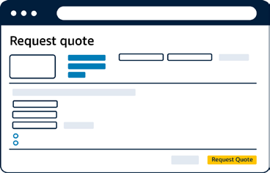



Simplify buying for Tennessee Counties and Departments
TCSA + Amazon Business Benefits
Full-cycle Emergency Management solutions
Request for Quote Tool
Supplier Diversity and Socially Responsible Purchasing
Data-driven analytics for innovative procurement
Free Business Prime membership
Fast, FREE shipping and unlimited users per account
Customized bulk purchase quotes that support compliant and efficient purchasing
Capability to request a discounted price on high volume purchases
Price held until quote expiration
Single source for certified sustainable, local, and diverse sellers and products
Gain tailored insights that uncover tail spend trends
Pay by Invoice
$5,000+ line of credit
Preparedness
Build a roadmap to more powerful purchasing
Support businesses identified as small-, minority-, woman-, veteran-, and LGBT-owned on Amazon Business.
Exclusive discounts
Up to 25% off thousands of essential items
Discover employee
buying habits
Recovery
Tax exempt purchasing
Automatic tax exemption with verified status
Set policies and track progress towards your organizational goals
Identify cost savings across suppliers and categories
Mitigation

