Slide 1
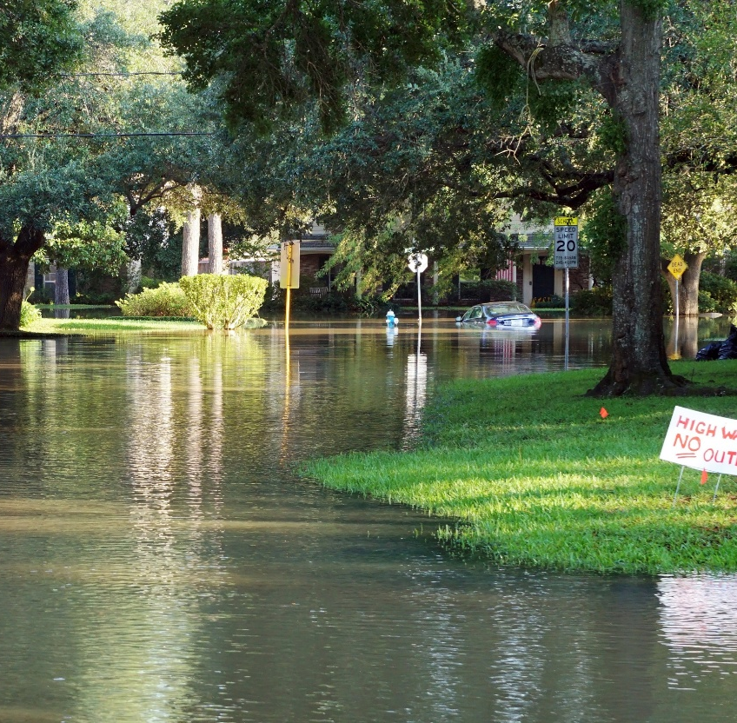

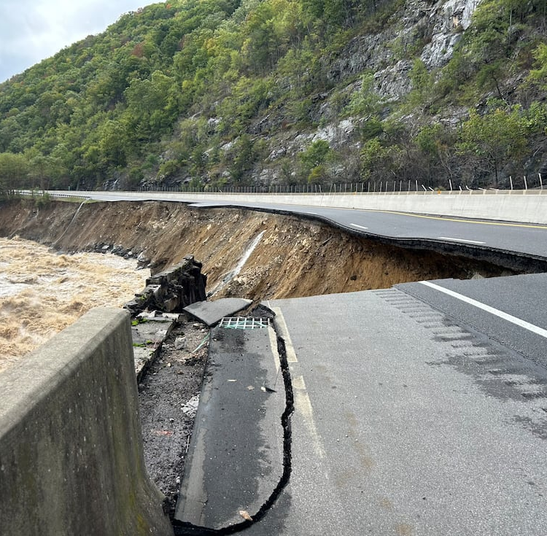
Transforming Preparedness & Response in Tennessee with Modern Flood Prediction
Modern approaches can help us predict flood impacts more accurately
Traditional flood models can’t keep up
Flood events are becoming more frequent, intense, and unpredictable
Notes:
Right now, we’re living in a world that’s moving at lightning speed. Technology is evolving faster than we can upgrade our phones, the climate keeps throwing us curveballs, and development trends are transforming our landscapes seemingly overnight. This convergence of factors has presented both incredible opportunities and significant challenges for those of us tasked with protecting our communities from floods.
Today, we’re going to focus on a specific challenge: the fact that, even with all of the recent technology advances, we’re still falling short in accurately predicting flood risks—not just for today, but especially for tomorrow. As the pace of change accelerates and development reshapes the landscape, flood events are becoming more frequent, more intense, and more unpredictable. The tools that we’ve traditionally relied on to predict flood risk are no longer sufficient. They struggle to keep pace with the complexities of our modern world.
Let’s start by acknowledging the limitations of the traditional models we’ve relied on for so long. These models—often based on hydrological and hydraulic principles—have served us well, and they continue to be the gold standard for flood risk mapping. However, they are largely static - based on historical data and assumptions that were established in a world that no longer exists. Flood patterns are evolving due to changes in climate and land use, and traditional models aren’t dynamic enough to predict where and when floods will occur, how severe they will be, and what areas will be most affected.
Take a moment to think about the challenges you’ve faced in your own work….no not that annoying coworker…How many of you have encountered situations where a rainfall event exceeded the predictions? Or where areas not previously considered flood-prone were suddenly overwhelmed by water? These are becoming more common occurrences, and they point to the urgent need for adaptive approaches to flood risk management.
This is where Artificial Intelligence & Machine Learning come in. While the words "AI" and "Machine Learning" may sound like the latest buzzwords, they represent powerful tools that are already reshaping industries—from healthcare to finance to transportation – flooding and floodplain management is no exception.
So, what exactly is AI and how can it help us predict floods more accurately?
AI refers to the capability of computers to perform tasks that typically require human intelligence, such as recognizing patterns, analyzing data, and making predictions. A subset of AI, Machine Learning, involves systems that can learn from data, identify patterns, and improve their accuracy over time without being explicitly programmed. In the context of flood prediction, AI and ML offer powerful tools for analyzing vast amounts of real-time data—such as weather forecasts, river levels, and elevation data—to generate more accurate, timely, and reliable predictions.
Unlike traditional models, which are static and based on past events, AI-driven models are dynamic and adaptive. They can continuously integrate new information, learn from it, and refine their predictions as conditions change. This ability to process and analyze large datasets in real-time allows AI and ML to account for the complex and ever-changing variables that influence flooding, such as evolving weather patterns, land use changes, and infrastructure development.
For flood risk prediction, this is a game-changer.
Let me share FOUR examples of how AI and Machine Learning are transforming flood prediction:

Slide 2
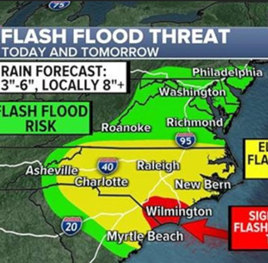
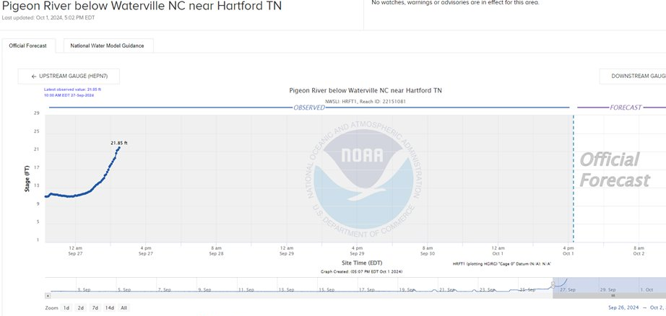
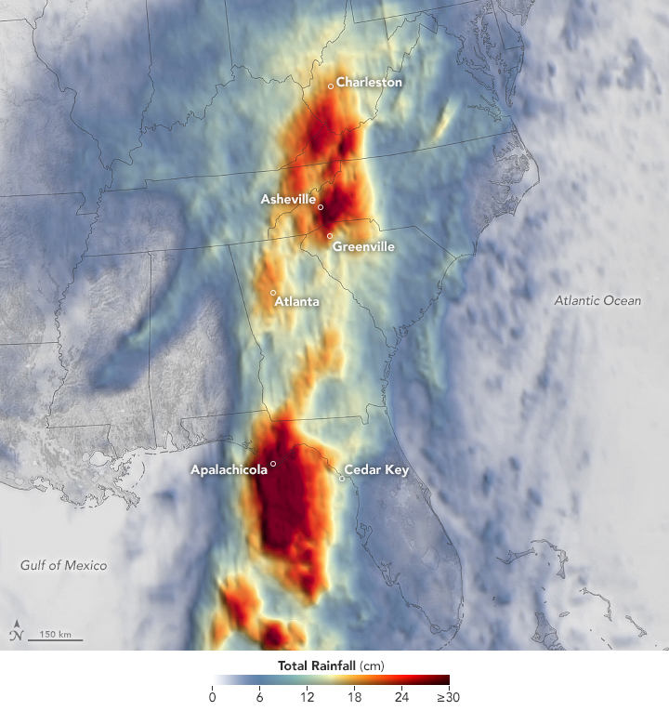
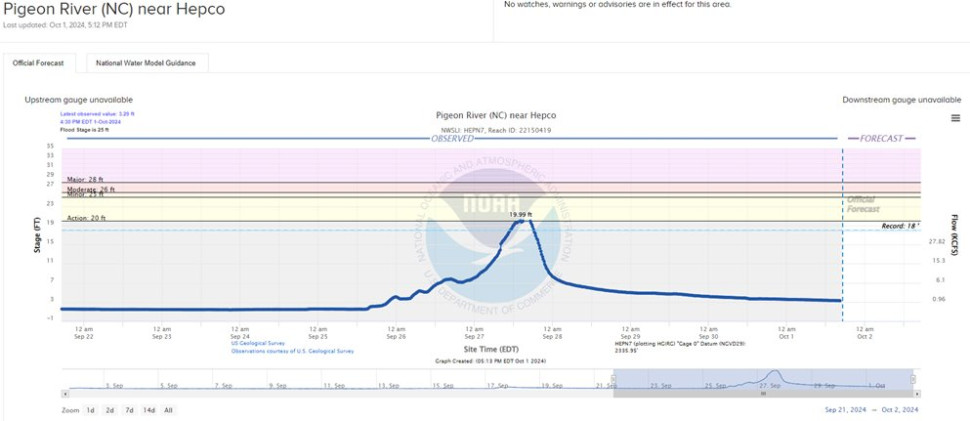
Hurricane Helene | Traditional Approach | Modern Way
FORECASTED FLASH FLOOD RISK
DAYS BEFORE EVENT
NEAREST GAGES SHOWED “NO ACTION STAGE” & “GAGE FAILURE” BEFORE & DURING FLOODING
AI PREDICTIONS BASED ON WEATHER FORECAST WERE GENERATED EVERY 15 MINUTES

Slide 3
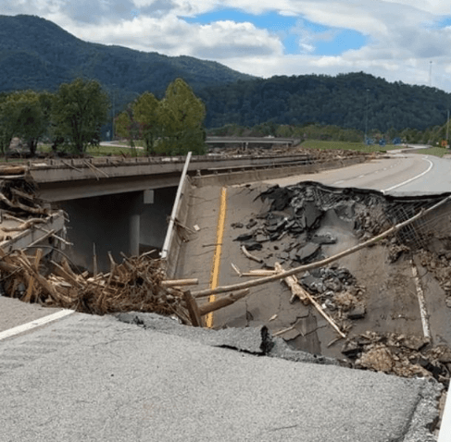
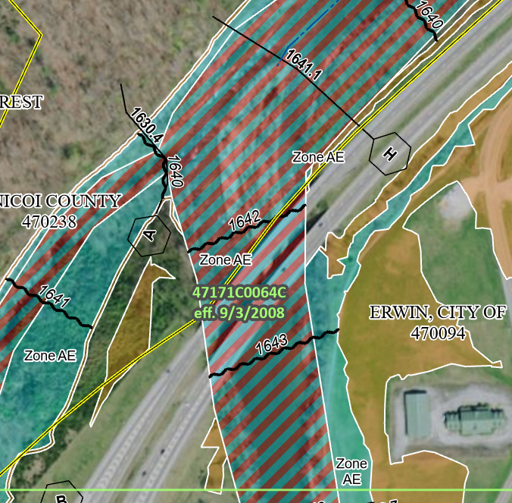
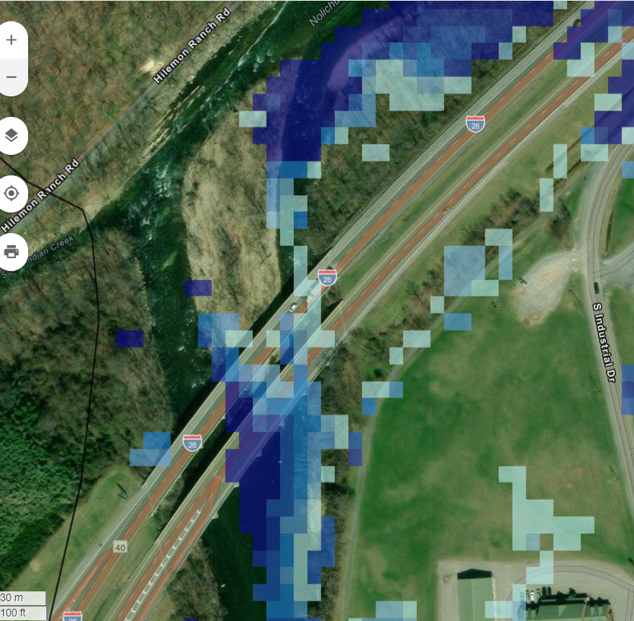
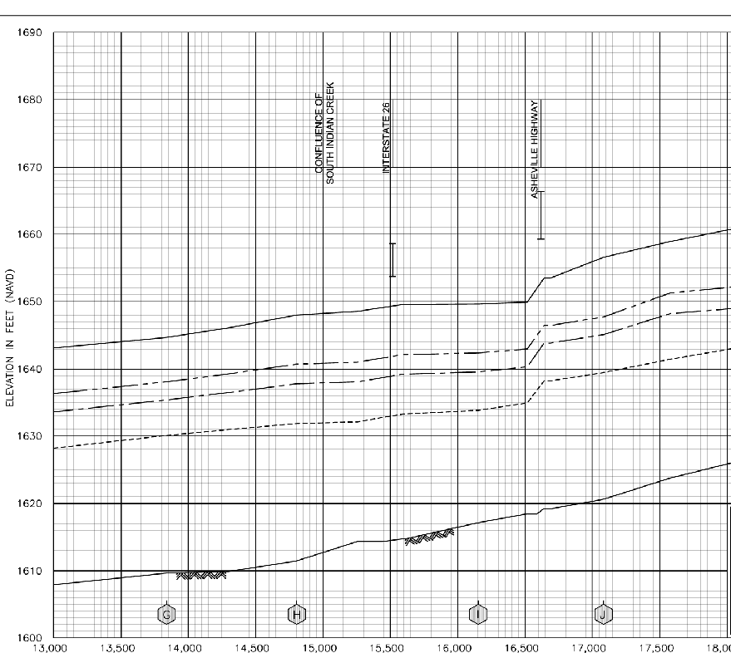
Hurricane Helene AI Generated Results
Flood Predictor Flash Flood Simulation for 12-inch Rainfall Extent Erwin, TN I-26 Bridges
Simulations supporting evacuation & response efforts at Erwin Tennessee also showed areas of high flash flood risk along the Nolichucky River at Interstate 26 due to steep terrain to the Northwest
Notes:
In Erwin TN at the I-26 bridges there was significant damage due to overtopping .
Understanding this risk from the FEMA maps which were updated in 2008 there's no indication that that water will come out of the Floodway channel
Though using AI to predict flood risk with the Weather forecast emergency managers can easily see significant overtopping, more than 2 ft of water over these bridges in the westbound lanes.

Slide 4
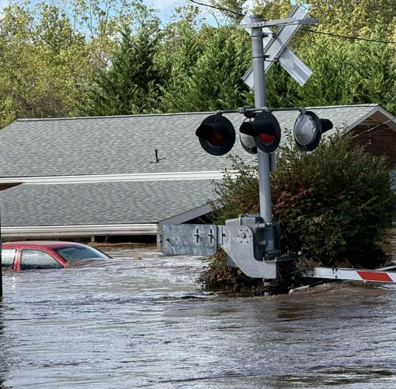
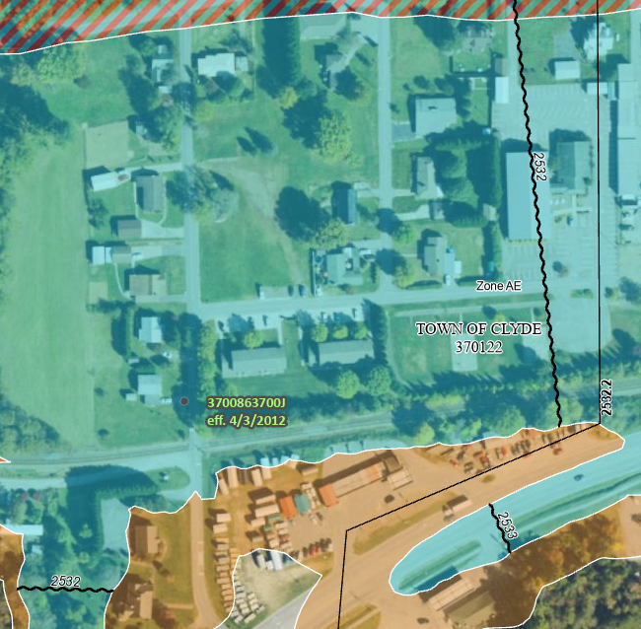
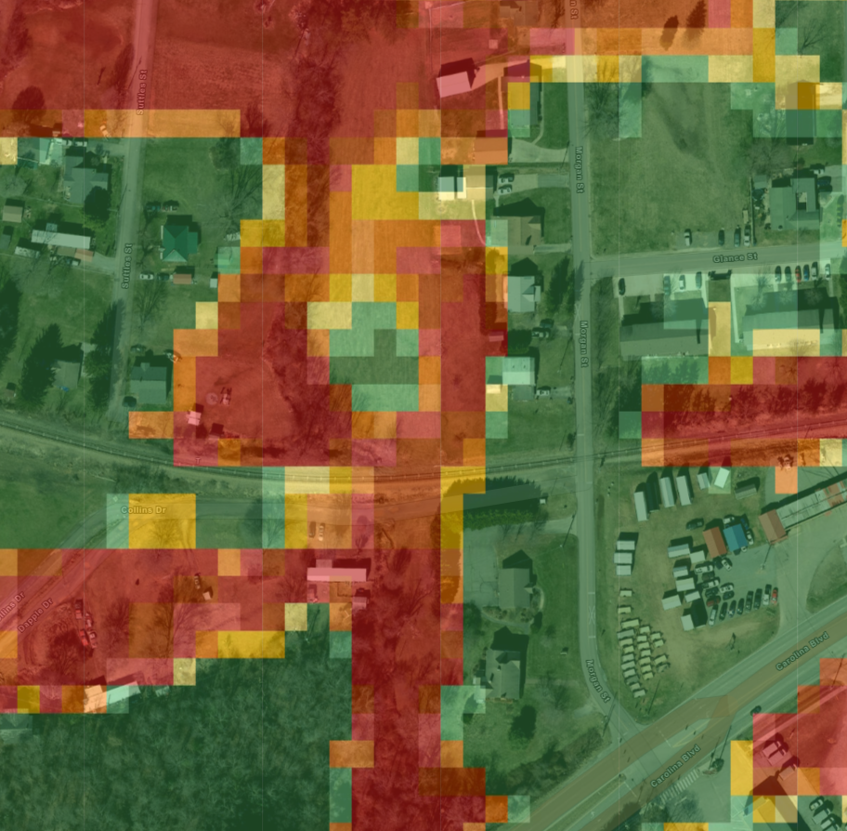
Hurricane Helene & AI Generated Results
Flash Flood Simulation for 24-inch Rainfall at Clyde, North Carolina
Due to their proximity to the Tennessee border watersheds in North Carolina were also simulated to support emergency managers with evacuation and response efforts - flood depths and probabilities correspond to photos taken of the event (note aerial & elevation data mismatch).
Notes:
Residential Flood Damage in in Clyde NC had water exceeding 4 to 5 feet In some areas
The FEMA map, updated in 2012, does show a 1% or 100 year floodplain - though the map is too generic to be actionable, resources couldn’t cover such a large area - and it appears as though homeowners were not warned of the flood impact .
The AI generated flood risk based on the actual weather forecast gives specific flood risk areas that would allow for better planning and even notifications to go to residences - warning of their potential risk – and at least giving a chance to move people and possessions, such as cars, to higher ground

Slide 5
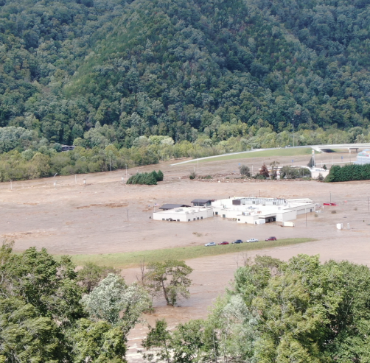
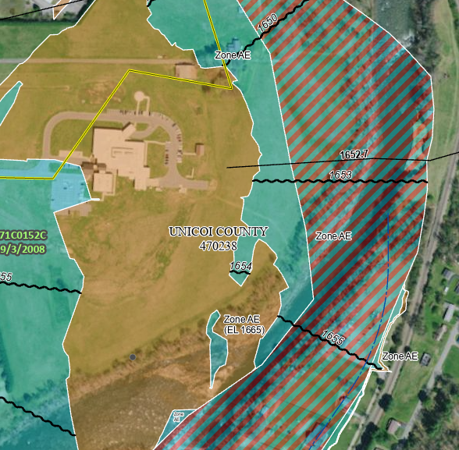
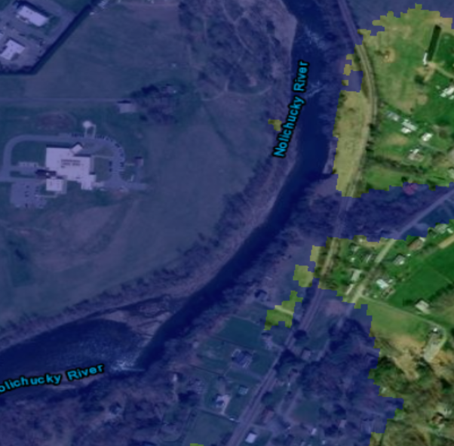
Hurricane Helene & AI Generated Results
Riverine Flood Predictor Results Simulation from US National Weather Model (NWM) Flows at Erwin, Tennessee
After the event Flood Predictor’s Riverine Flooding simulation from available National Weather data corresponds to events captured by photography and satellite data in a community on the Tennessee & North Carolina border.
Notes:
I’m sure everyone here recalls the Hospital imagery from this storm, or the loss of life at the Factory upstream from this area.
The FEMA map for this area was last updated in 2008 and shows the hospital in a 500-year floodplain while the parking lot is in 100-year floodplain.
An emergency manager would likely assume this area to be low risk with limitedrisk largely due to the fact that there’s was limited information about weather forecast and runoff that would correlate to these FEMA maps being actionable.
Of course the AI generated flood risk, associated with that weather forecast, showed widespread risk in this area – one reason for this level of accuracy from the AI approach could also have been that it included the latest Land Use and Elevation data updates which would take into consideration significant road and infrastructure development that may have contributed to changing flood risk in this area.

Slide 6
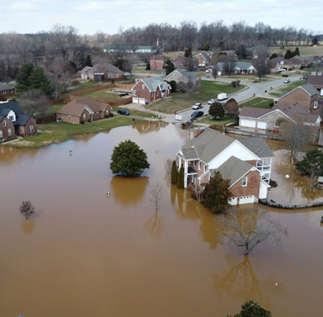
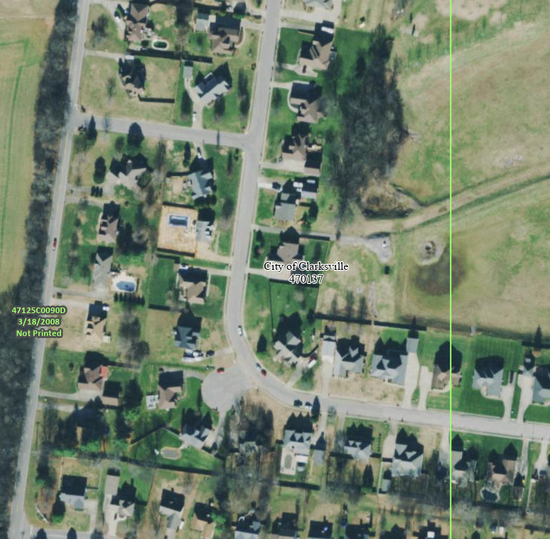
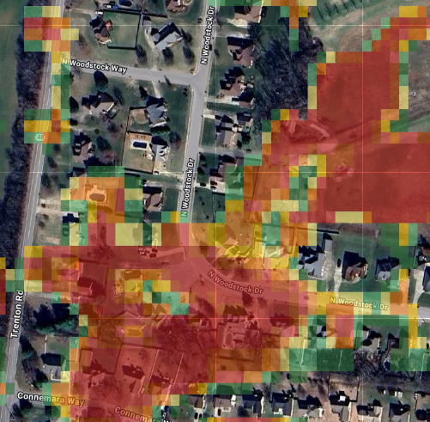
February 15-16, 2025 & AI Generated Results
Flash Flood Simulation for 6.28-inch Runoff at Clarksville – Montgomery County, Tennessee
Notes:
One last example of how traditional approaches are failing us and how a modern approach can be leveraged to reduce a community’s risk – this one is from Middle Tennessee in Clarksville from a storm this past February.
There was widespread damage in residential areas in areas that haven’t been studied by FEMA, no one was even aware of the risk. Homeowners interviewed confirmad this saying they had no idea this area would fflood and therefore had no reason to buy Flood Insurance.

Slide 7
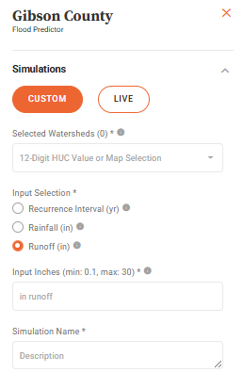
A Call to Action for the modern approach
Where in Tennessee is Flood Predictor Available?
TN is the FIRST State that is fully available
What is it Used For?
PLANNING! Currently using TN Plan for Community Planning & Preparation (Knox, Shelby, WTNRBA,++)
Is Training Available?
Yes! Contact us to get access through September
Why is it better?
The ONLY answer for what happens when rain hits the ground – precise planning & risk information.
Notes:
Tennessee is not unique in THIS PROBLEM, I could show similar images from communities across the country.
However, Tennessee is unique that it is the only state in the USA to have Access to THE MODERN TECHNOLOGY I showed today.
This is a call to action to use it to our advantage, understanding risk in our communities to help protect our citizens and their property.

Slide 8



Stantec & Flood Predictor Contact Info
Jeff Albee
Vice President of Digital Consulting & Solutions
+1 615-885-1144 | Office
+1 615-944-9009 | Mobile
Jeff.Albee@Stantec.com
Susan Marlow, GISP
Director of Business Development, Digital Consulting & Solutions
615-499-7158 (direct)
615-504-1541 (mobile)
susan.marlow@stantec.com
Click any of the logos below for additional information about Flood Predictor

Slide 9
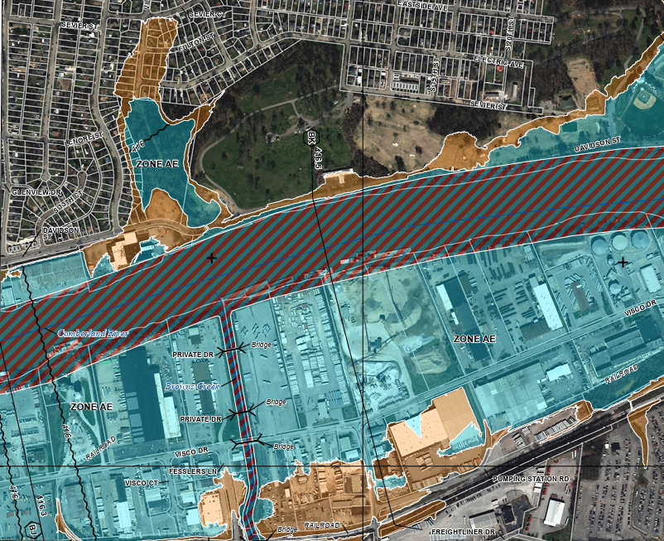
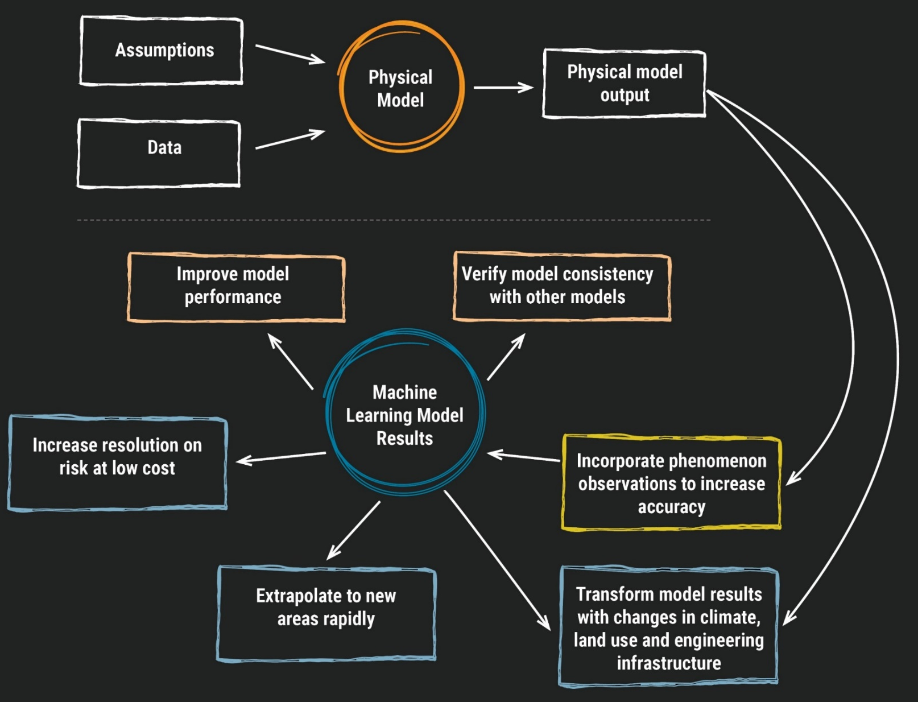
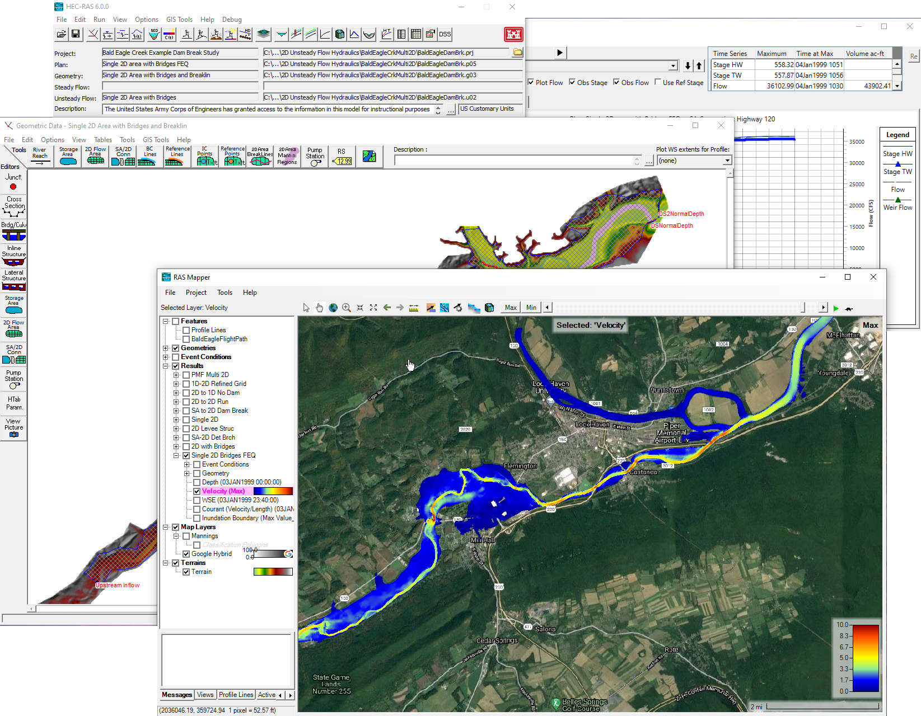
Trained with Physical Models
Leveraging your investment in engineering

Slide 10
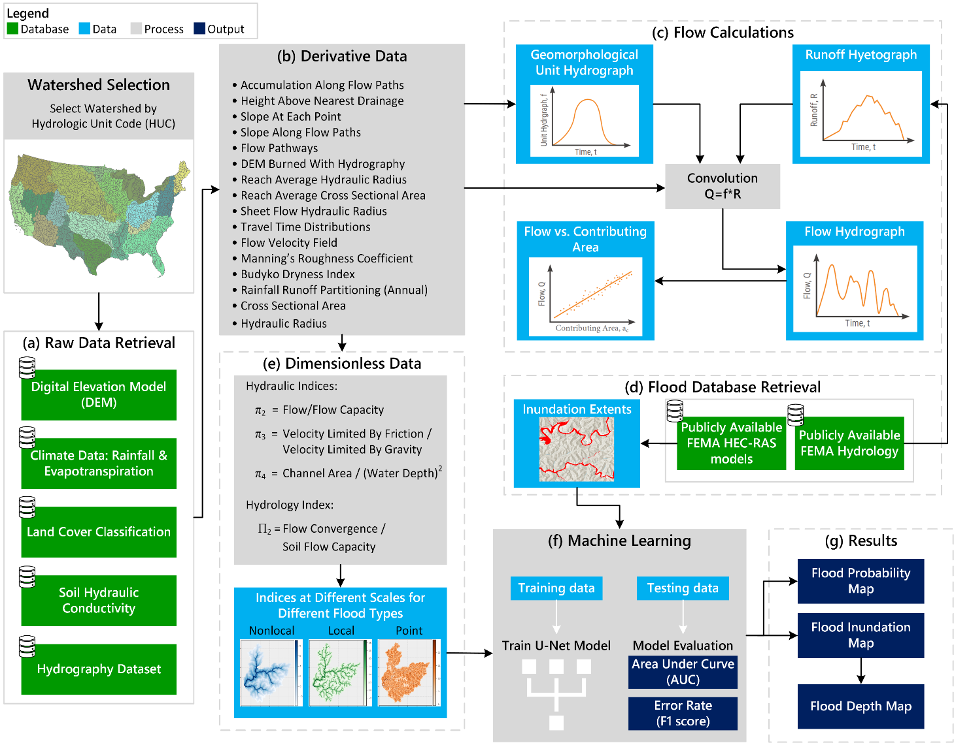
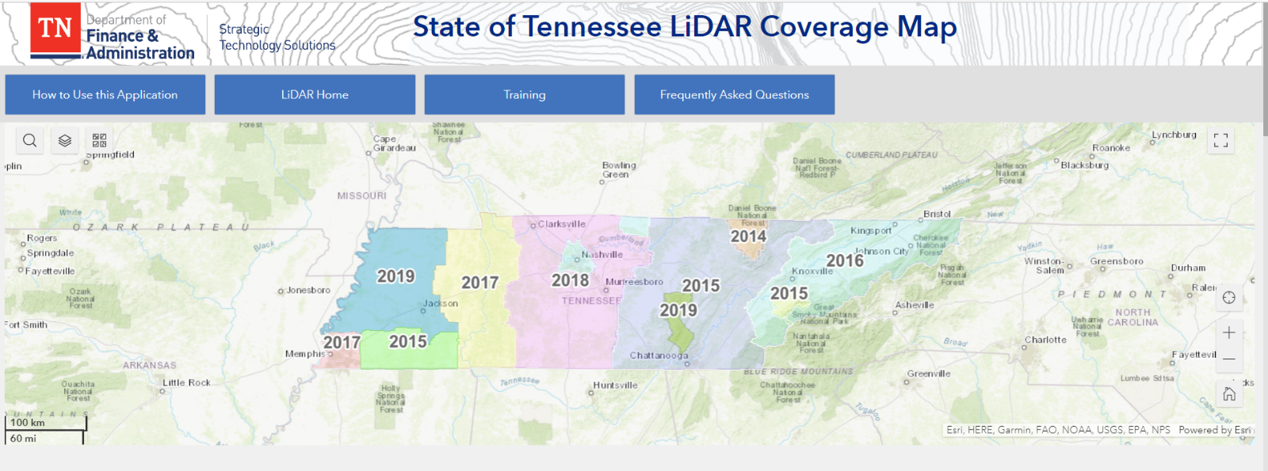
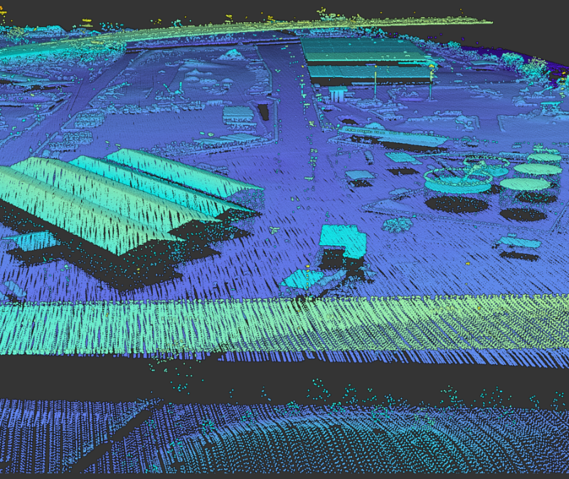
Uses Best Available Data Inputs
Can be updated as often as your data is…
PREPARE FOR THE UNEXPECTED
Point Cloud Example, Nashville

Slide 11
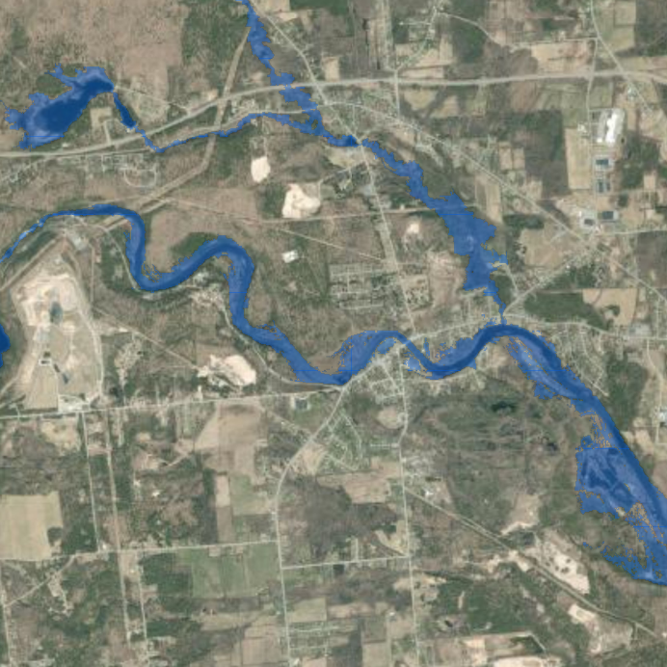
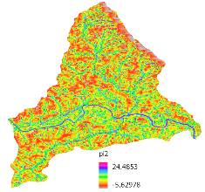
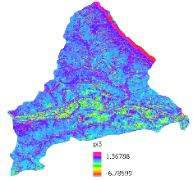
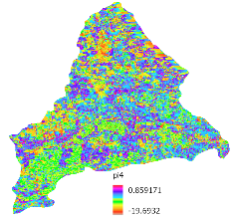
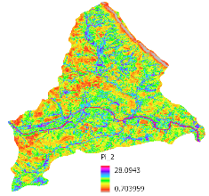
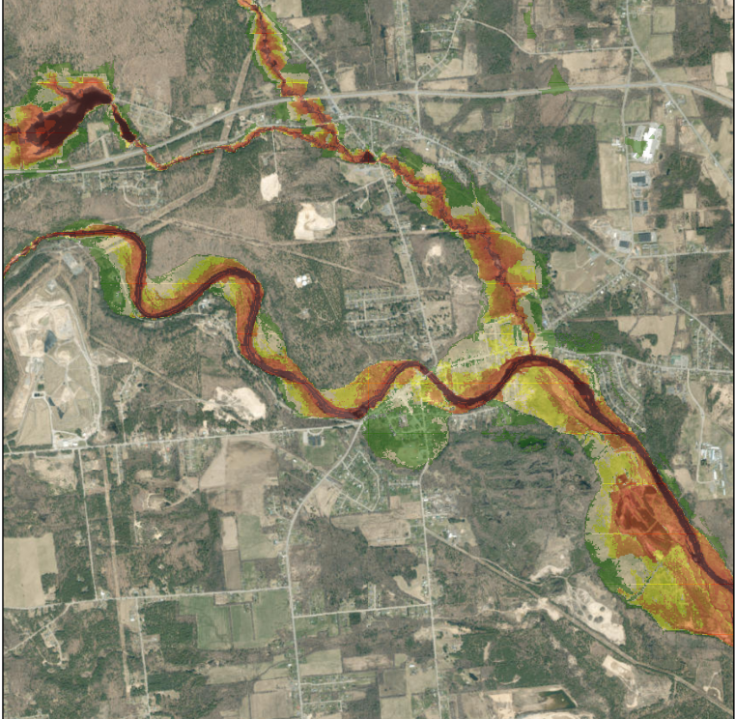
Model Predictions
User Defined
Hydrologic
Condition
(e.g. 10%, 1%, 0.2%)
Flood Prediction
Dimensionless Engineering Features (Prediction Site)
AI Engine
PREPARE FOR THE UNEXPECTED
Hydraulics Index 1
Hydraulics Index 2
Hydraulics Index 3
Flood Probability
Hydrology Index
Processing
Time
0-3 Hours
0-20 Minutes
Notes:
After creation of the dimensionless features we then build/train the machine learning model.
Machine learning can expedite decisions
by algorithmically finding patterns in data that in turn are used to make correct inferences on brand new data — expediting the engineering process.
We use particular storm events/conditions, flows, and resultant flood maps in model training.
Should I go into details regarding where these Floodplain outputs come from?– training off inflows and runoff that are applied to HEC RAS models as boundary conditions and the resulting innudation areas/flood plains
Because our dimensionless feats are so generalizable, we don’t need as much training data to training the model– if we capture an appropriate scale of heterogeneity across the landscape. (e.g. don’t need to capture flooding specifically in NY just need to capture flooding)
The dimensionless features along with storm and flow inputs are used to predict flooding. Model is calibrated and parametrized. Once we get our desired performance metrics, we have our Flood Predictor Model.

Slide 12
Model Scenarios
Flood Predictor
Flash Flooding
Situational
Riverine Flooding
Situational
Recurrence
Recurrence
What does flooding look like tomorrow or next week?
What does flooding look like for a 50- or a 100-year event?
PREPARE FOR THE UNEXPECTED
Notes:
Flood Predictor currently supports both flash and riverine flood events.
Flash/Pluvial- surface water flooding; when heavy rainfall creates a flood independent of an overflowing water body
Riverine/Fluvial- when excessive rainfall over an extended period of time causes a river to exceed its capacity
With flash and riverine flooding, we can predict flooding for a specific event (Situational) or flooding for various return intervals (Recurrence).
Situational flash flooding is where weather forecasts are needed. We use the curve number approach to predict a runoff amount for a predicted (or forecasted) rainfall estimate. That runoff amount is then input into Flood Predictor and we’re able to predict flash flooding for that specific rainfall estimate.
Riverine – NWM observed/recorded or predicted flows

